Slide 1
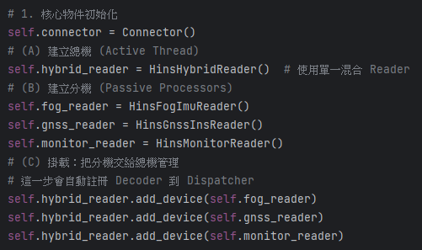
總機 -> 分機 概念

Slide 2
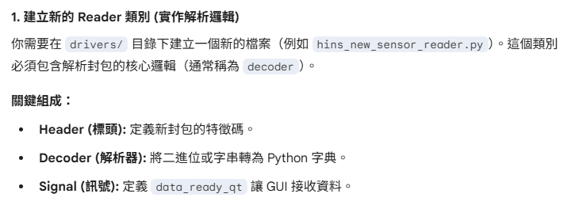
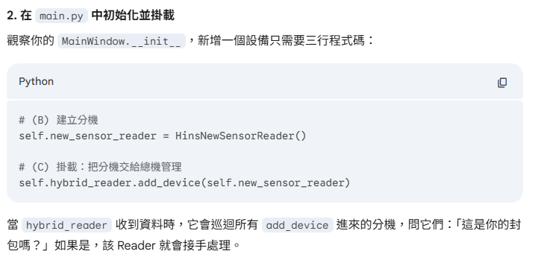

Slide 3
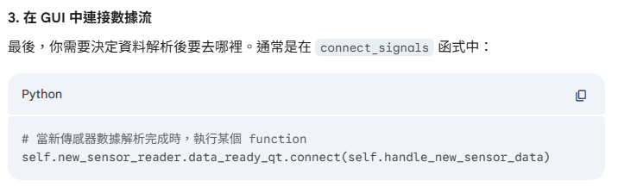

Slide 4
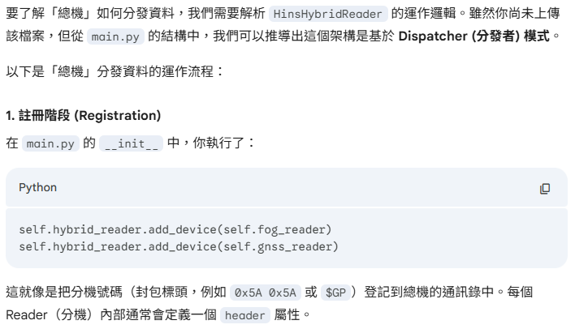
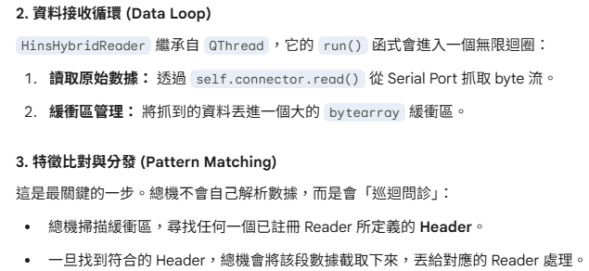

Slide 5
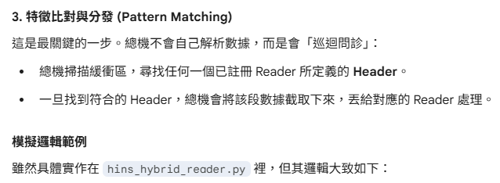
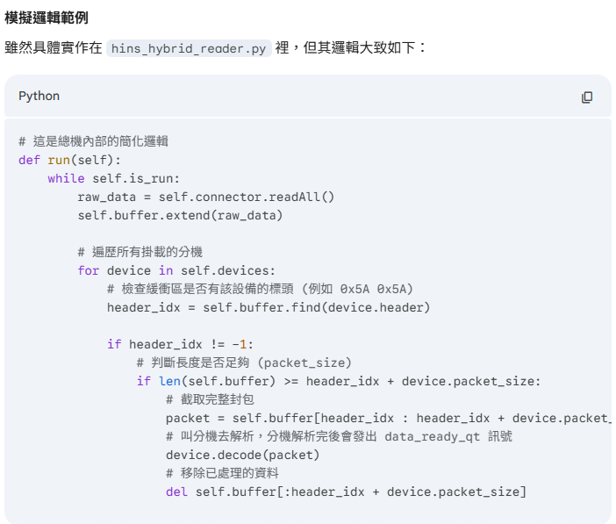

Slide 6
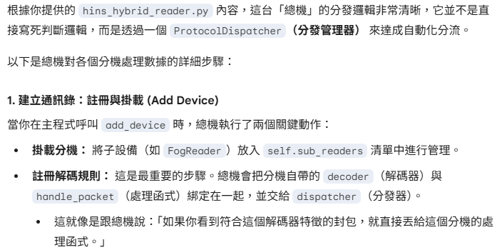
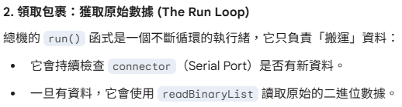

Slide 7
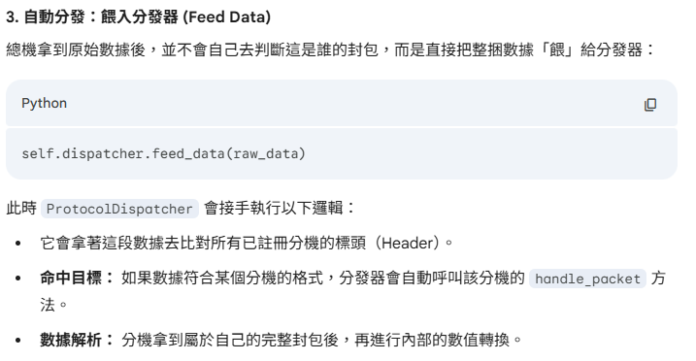

Slide 8
Hybrid reader
add_device
sub_readers{
reader_1
reader_2
reader_3}
self.dispatcher.add_parser(reader_1.decoder, reader_1.handle_packet)
ProtocolDispatcher
add_parser
Feed_data
parsers{
[Parser1, callback1],
[Parser2, callback2],
[Parser3, callback3]
)
parsers{
[Parser1, callback1],
[Parser2, callback2],
[Parser3, callback3]
)

Slide 9
Raw data in
Decoder_1
Decoder_2
Decoder_3
Packet come ?
N
Decoder_1
Decoder_1
Decoder_1

